Slide 1
Database Design & Normalization
Module 2

Slide 2
Module 2 - Database Design & Normalization
Database vs Schema
Tables, Rows, Columns
Database Design Principles
Normalization
1NF, 2NF, 3NF
Removing redundancy
Real-world examples

Slide 3
Part 1: Database vs Schema
What is a Database?
A database is a collection of related data organized for easy access.
Example:
ecommerce_db
college_db

Slide 4
What is a Schema?
A schema is the blueprint or structure that defines how data is organized and stored in a database.
It outlines the tables, fields, relationships, views, indexes, and other elements within the database.
Simple explanation:
Database = Container
Schema = Folder inside container
Tables = Files inside folder

Slide 5
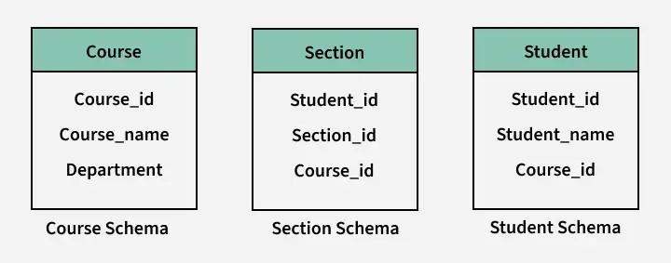
Schema

Slide 6
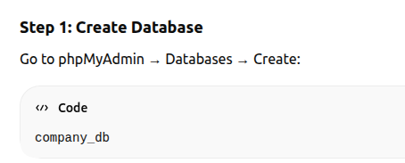
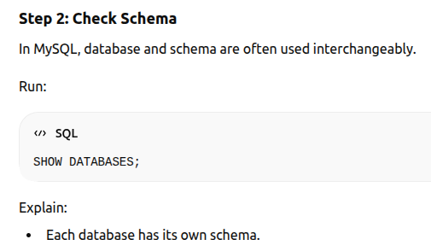
Practical – Using phpMyAdmin

Slide 7
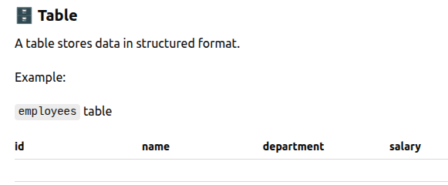
Part 2: Tables, Rows, Columns

Slide 8
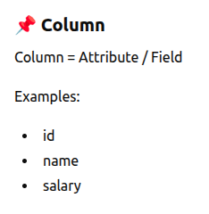
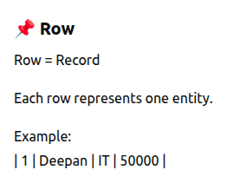
Rows & Columns

Slide 9
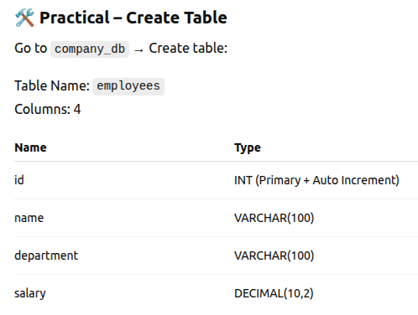

Slide 10
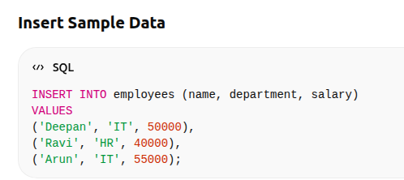

Slide 11
PART 3: Database Design Principles
Good database design means:
1. Avoid Data Redundancy
2. Use Proper Data Types
3. Use Primary Keys
4. Use Foreign Keys
5. Normalize Data
6. Keep Data Atomic

Slide 12
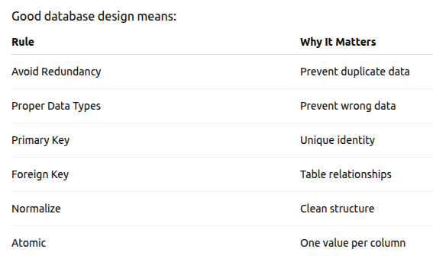

Slide 13
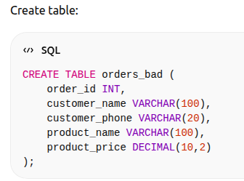
Bad Design Example

Slide 14
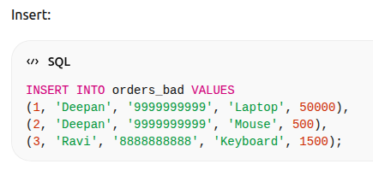
Bad Design Example

Slide 15
PART 4: Normalization
Normalization is the process of organizing data in a database to:
Reduce data duplication
Avoid data inconsistency
Improve data integrity
Make updates safer and cleaner
In simple words:
Normalization = Splitting big messy tables into smaller related tables in a smart way.

Slide 16
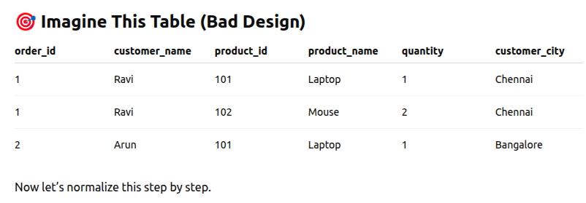

Slide 17
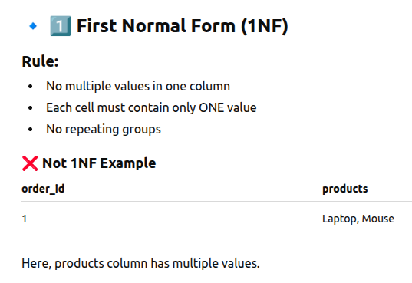

Slide 18
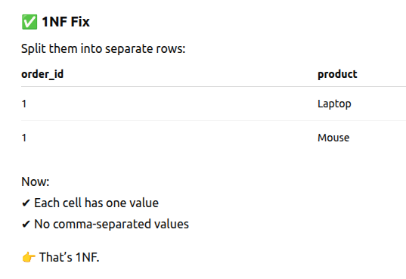

Slide 19
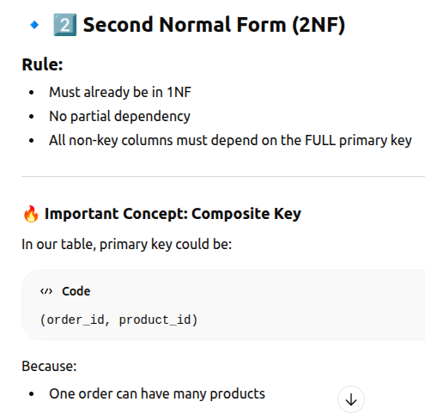

Slide 20
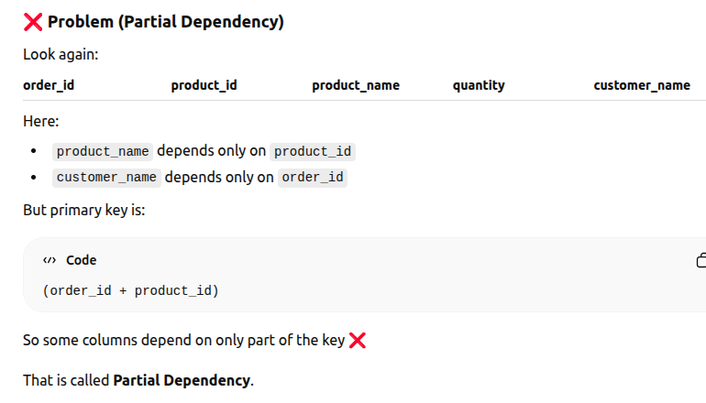

Slide 21
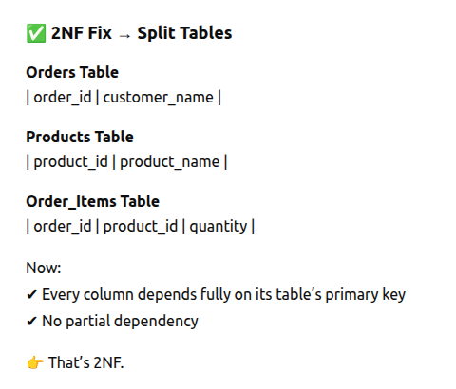

Slide 22
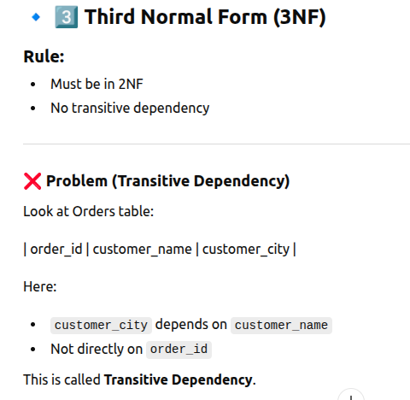

Slide 23
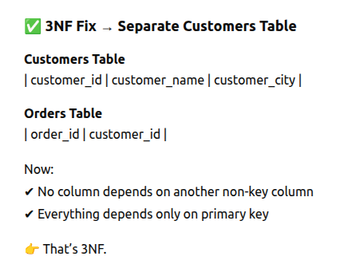

Slide 24
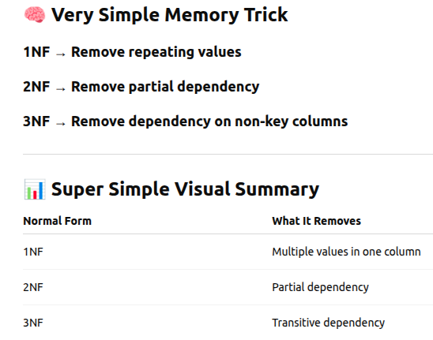

Slide 25
Step-by-Step Real World Example (E-Commerce)
Query

Slide 26
Visual ER diagram

Slide 27
What is ER Diagram?
ER = Entity Relationship
It visually shows:
📦 Entities (Tables)
🧾 Attributes (Columns)
🔗 Relationships (Connections)
🔑 Primary Keys & Foreign Keys

Slide 28
Entities (Tables)
In our system we have:
Customers
Orders
Products
Order_Items
Each one is an Entity.

Slide 29
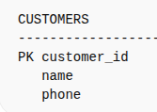
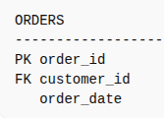
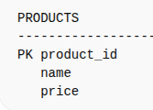
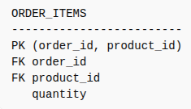
Visual ER Diagram Structure

Slide 30
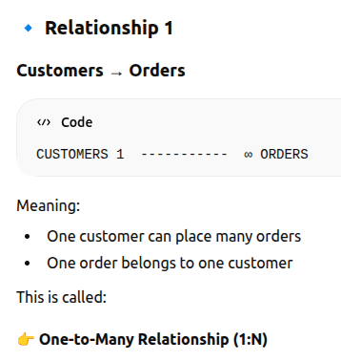
Relationships (Very Important)

Slide 31
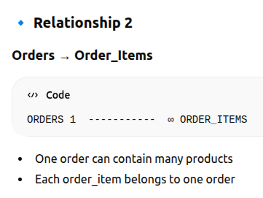

Slide 32
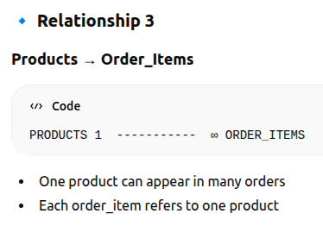

Slide 33
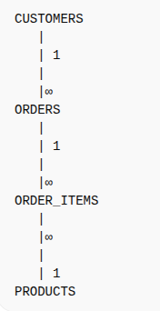
Complete Visual ER Diagram (Combined)

Slide 34
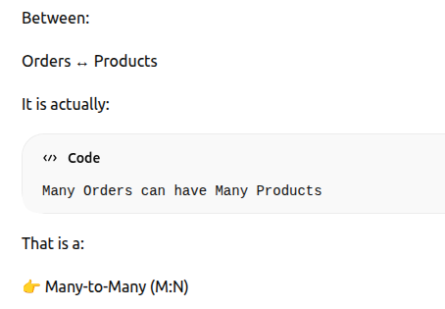
Understanding the Many-to-Many Concept

Slide 35
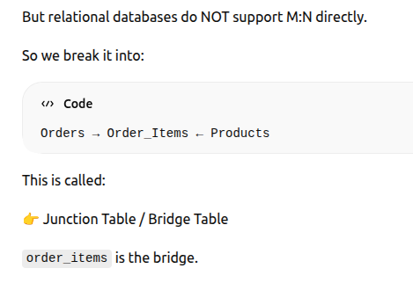
Understanding the Many-to-Many Concept

Slide 36
Why ER Diagram is Important?
✔ Before coding
✔ Helps plan structure
✔ Avoids redundancy
✔ Shows relationships clearly
✔ Used in interviews

Slide 37
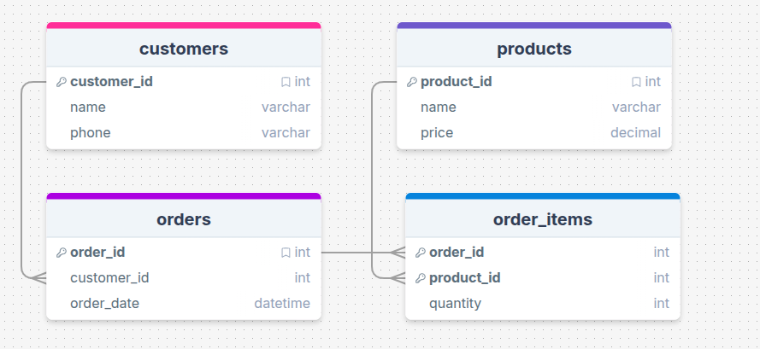

Slide 38
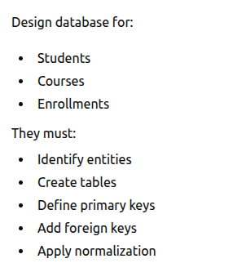
Classroom activity

Slide 39
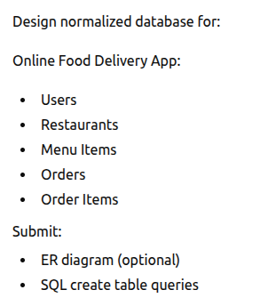
Exercise 1

Slide 40
Exercise 2
Link

Slide 41
Session End

